Slide 1
Automation with esp32 and Iot

Slide 2
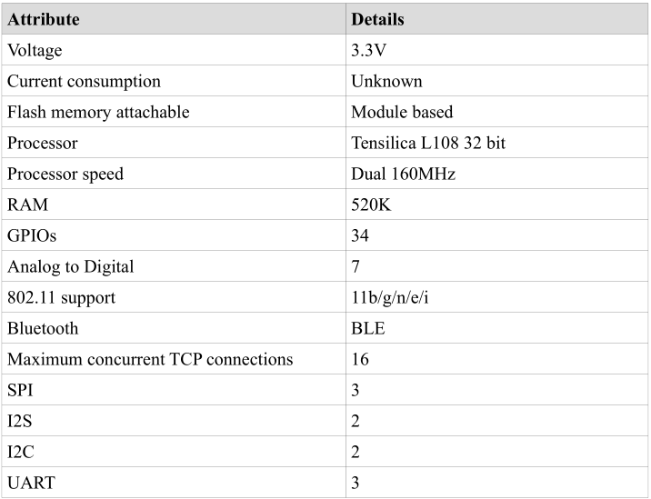
ESP32 specification
https://www.espressif.com/sites/default/files/documentation/esp32_datasheet_en.pdf

Slide 3
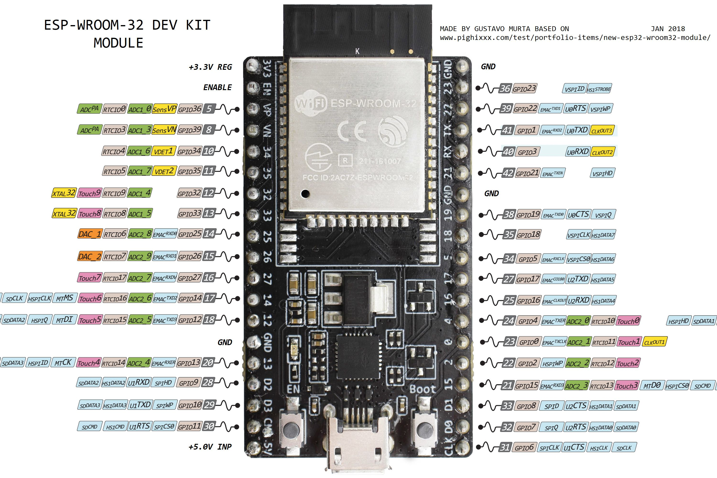
Esp 32 devkit pinout

Slide 4
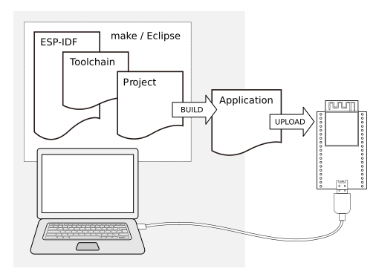
Espressif IoT Development framework
https://docs.espressif.com/projects/esp-idf/en/stable/get-started/

Slide 5
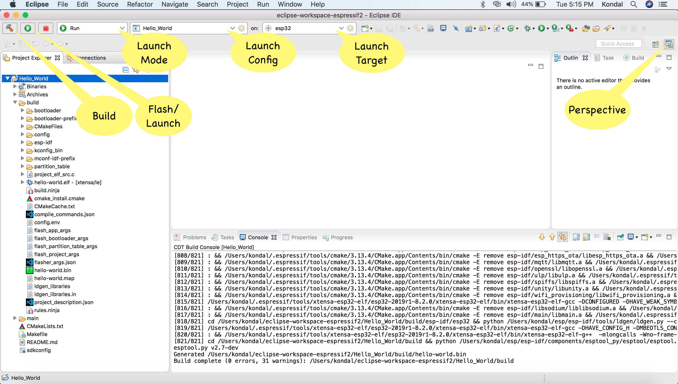
Espressif IDF Eclipse Plugins
https://github.com/espressif/idf-eclipse-plugin

Slide 6
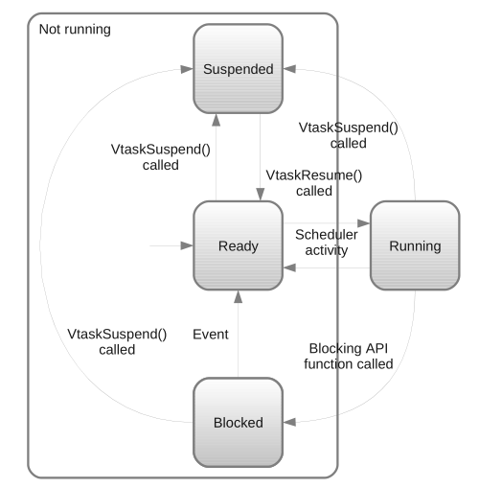
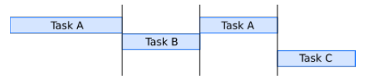
Using FreeRTOS
https://www.freertos.org/
https://www.freertos.org/Documentation/161204_Mastering_the_FreeRTOS_Real_Time_Kernel-A_Hands-On_Tutorial_Guide.pdf
http://wiki.csie.ncku.edu.tw/embedded/FreeRTOS_Melot.pdf
http://microsin.net/programming/arm/freertos-part1.html

Slide 7
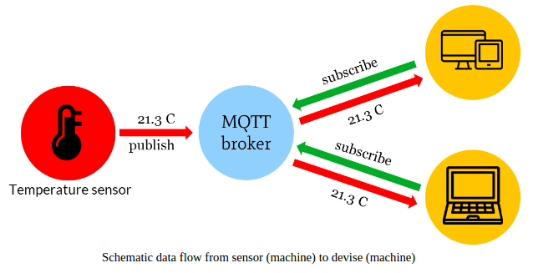
Why MQTT
It’s a lightweight protocol. So, it’s easy to implement in software and fast in data transmission.
It’s based on a messaging technique. Of course, you know how fast your messenger/WhatsApp message delivery is. Likewise, the MQTT protocol.
Minimized data packets. Hence, low network usage.
Low power usage. As a result, it saves the connected device’s battery.
It’s real time! That’s is specifically what makes it perfect for IoT applications.
https://1sheeld.com/mqtt-protocol/?__cf_chl_jschl_tk__=69bd5a2c20de5680f80a1318fb108016309d8c3a-1581930145-0-AcoJ6QtQ39a_6nKmDPwF7RQCI0mj2cniJXM7inlm2al7lvo0I8Jg-PgwKezhGaEgKCZlZ0Emb6rqk_TZLyL2R6IPHZTMzBZRTVWMdEJE1V3IkmsNY2d0h6pcNs7rcuxCQnIOX5n3QGm2bE53WPyx-aAGnvTG5uWcs4N6NxoG9bpGRebhEJVYNJBiYJREn4iZLLmswltXvfhH22QpDjfjPENwhZFXfa2C-o9OH9eh1r78rid68OMXWsc6upjl8K5UQw5ZfYDYSf4VfusrGv3BkiJPpZ8vhwECzNxB0nzMPUNt

Slide 8

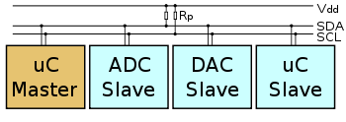
I2c device library
The I2C Device Library (i2cdevlib) is a collection of uniform and well-documented classes to provide simple and intuitive interfaces to I2C devices.
https://github.com/jrowberg/i2cdevlib

Slide 9
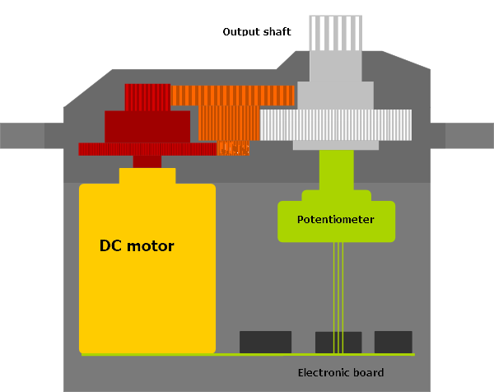
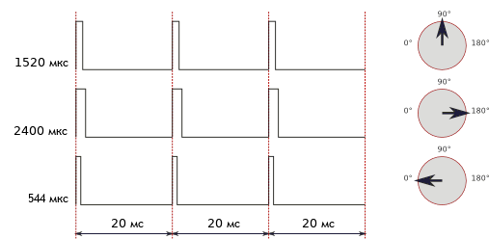
Servo drive and Pulse Duration Modulation

Slide 10
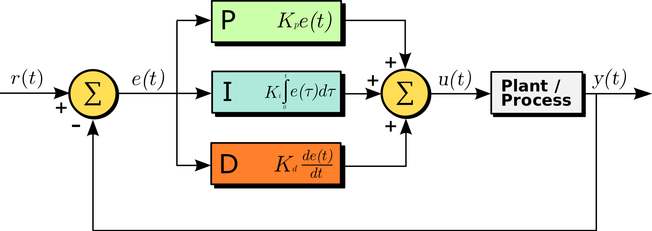
PID controller
A proportional–integral–derivative controller (PID controller or three-term controller) is a control loop mechanism employing feedback that is widely used in industrial control systems and a variety of other applications requiring continuously modulated control. A PID controller continuously calculates an error value {\displaystyle e(t)}e(t) as the difference between a desired setpoint (SP) and a measured process variable (PV) and applies a correction based on proportional, integral, and derivative terms (denoted P, I, and D respectively), hence the name.

Slide 11
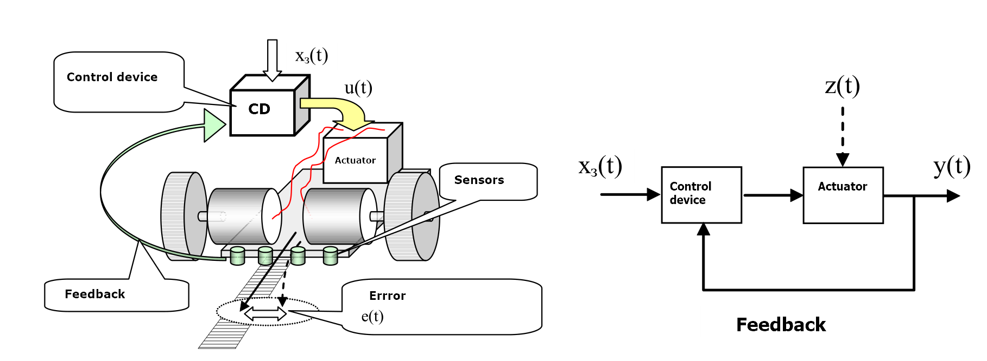
feedback system diagram
Feedback is a way to account for errors in control

Slide 12
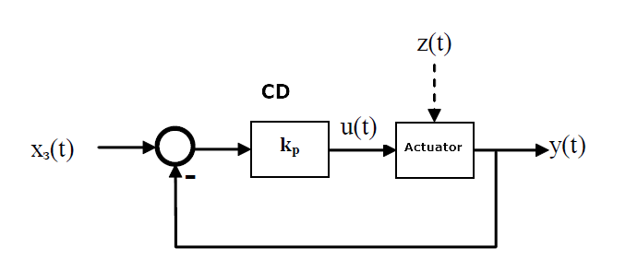
proportional control
W(p) = u(p)/e(p) = kр.
e(t) = x(t) - y(t)
Advantages:
- simplicity;
- performance.
Disadvantages:
- limited accuracy (especially when managing objects with
great inertia and delay);
- overshoot.
//Program implementation
float KP = 10.0; //Proportional ratio
float p_ctrl(float error) {
return = KP*error;
}

Slide 13
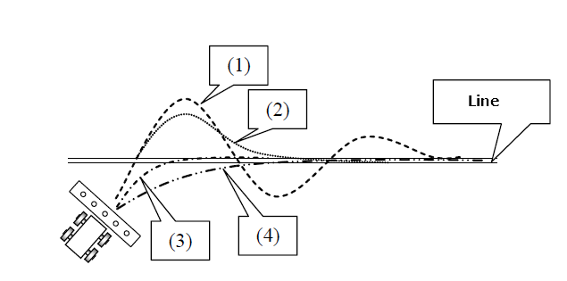
Control quality
Trajectory (1). kp is large (say, kp = 10). The system begins to oscillate. Moreover, the amplitude of the oscillations can be large. The magnitude of the maximum deviation of the trajectory from the given is called overshoot. The less this overshoot, the better.
Trajectory (2). kp is less (for example, kp = 5). The system behaves better. But the overshoot is great.
Trajectory (3). kp = 2. The car, without making hesitation, goes to the track. This is the best management.
Trajectory (4). kp is small (kp = 1). Exit to the track is also carried out without hesitation, but much slower.
In the theory of automatic control, two main modes of system operation are distinguished - steady-state mode and transitional mode. To clarify the difference between them, let us return to our example with the movement of our platform along the line.
The steady-state is the operating mode of the system, when all preliminary actions are completed (we clearly went to the track) and the car travels in a relatively straight section.
The transition mode is the beginning of work when our car starts or “road conditions” change sharply (sharp turns, breaks in the track, etc.).

Slide 14
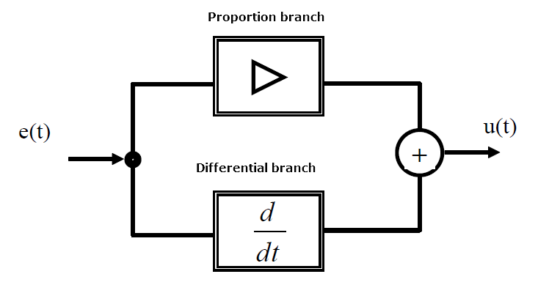
Proportional-differential control
W(p) = kp + kd = kр + kd Tdp
upd(t)= up(t) + ud(t) = kp*e(t) + kd*de/dt
//Program implementation
#define KP = 10; // Proportional ratio
#define KD = 0.1; //Differential ratio
float old_error = 0; // Previous error value
float pd_ctrl(float error, float y) {
unsigned long now = get_time();
unsigned long time_change = (now - last_time);
float up, ud;
//Proportional branch
up = kp*error;
//Differential branch
ud = kd*(error-old_error)/time_change;
old_error = error;
return up+ud;
}
Advantages:
- highest performance;
- the regulator responds to the rate of change.
Disadvantages:
- low accuracy;
- sensitivity to noise.

Slide 15
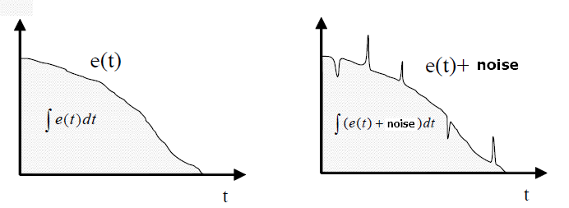
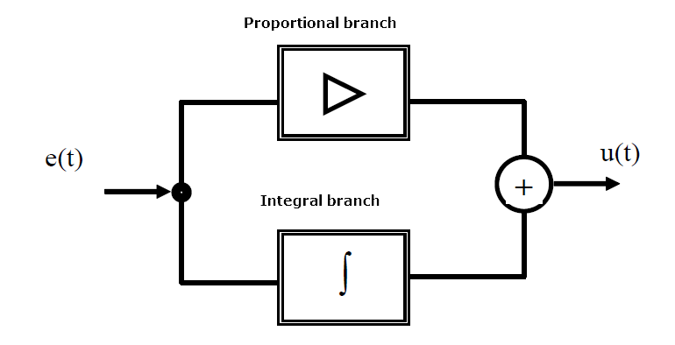
Integral control
Advantages: better accuracy in the steady state compared to the P-controller, and with a certain ratio of the coefficients kp and ki, the controller provides good performance in transient modes.
Disadvantages: worse properties in transient conditions (lower speed and greater oscillation).
W(p) = ki/p=kи/(Tip)
//Program implementation
float KP = 10; // Proportional ratio
float KI = 0.001; // Integral ratio
#define MIN 2.0 // Min integral value
#define MAX 10.0 // Max integral value
float sum = 0; // Sum of errors
float pi_ctrl(float error) {
float up, ui;
// Propportional branch
up = KP*error;
// Integral branch
sum = sum + error;
//Limit checking
if(sum < MIN) sum = MIN
if(sum > MAX) sum = MAX;
ui = KI*sum;
return up+ui;
}

Slide 16
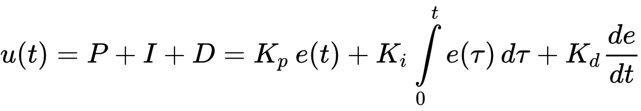
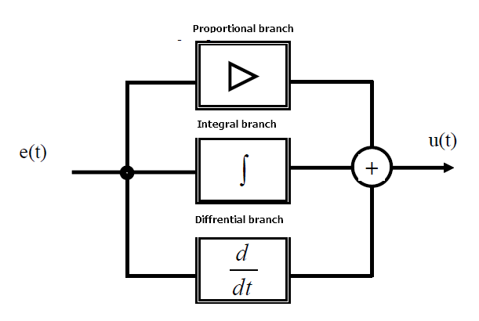
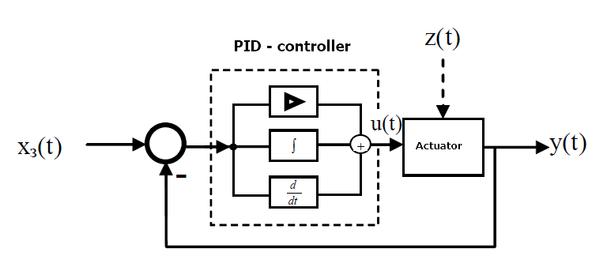
Proportional-Integral-Differential Control
,
W(p) = kp + ki/p + kdp.
// Program implementation
#define min 2.0 // Min integral value
#define max 10.0 // Max integral value
//Proportional ratio
float kp = 10;// Integral ratio
float ki = 0.001; // Differential ratio
float kd = 1; // Sum of errors
float sum = 0; // Previous signal value
float old_error = 0;
float pid_ctrl(float error, float y) {
unsigned long now = get_time();
unsigned long time_change = (now - last_time);
float up, ui, ud;
// Proportional branch
up = kp*error;
// Integral branch
sum = sum + error;
//Limit checking
if(sum < MIN) sum = MIN;
if(sum > MAX) sum = MAX;
ui = ki*sum;
// Differential branch
ud = kd*(error- old_error)/time_change;
old_error = error;
return up + ui + ud;
}

Slide 17
Component Setup
1. Setting the proportional component
Zero the coefficients ki and kd. They do not interest us yet. We will deal with kp, varying its value, say, from 1 to 100. First we set the value of kp equal to 1. If the system very slowly enters the line, then k p must be increased. If oscillations begin, then kp must be reduced. However, some recommend the following methodology for changing coefficient values. First, set the small kp value. Let's say there is no hesitation. Next, increase this value 10 times until the oscillations begin. Now we reduce the value of the coefficient kp, but not 10 times, but 2 times. And so on until the vibrations stop. Etc. Those. we search for the desired value, first using large steps, and then all smaller ones.
2. Configuring the integrated component
The value of the coefficient of the integral component ki should be small in comparison with c kp. It is recommended to take a number from 0.0001 to 0.01 as the initial value of the coefficient ki. The procedure for searching (selecting) the coefficient ki is exactly the same as the coefficient of the proportional component (first, large steps, and then small). Too large a value of the coefficient ki also manifests itself in the appearance of oscillations.
3. Setting up the differential component
If we are sure that the noise in our system is too high, then we can introduce a differential component. To configure kd, we first set the value of this coefficient equal to 0. Next, we set some small value of the coefficient of the proportional link kp (for example, kp = 1). The main thing is that the value of kp should be such that the system does not oscillate at a zero value of kd. Next, we establish some small initial value of the coefficient kd (for example, kd = 0.1). We will increase the coefficient kd until erroneous oscillations caused by small noise become apparent. Moreover, fluctuations from too large a coefficient occur much faster than oscillations from an insufficient coefficient. It is recommended to set the coefficient to half or a quarter of that at which fluctuations start from its too large value. The main thing in this process is on time
make sure that the system behavior is adequate (the car behaves well on the track).
4. PID controller tuning by Ziegler method
To select kp, ki and kd, one can use the empirical Ziegler method. It does not guarantee optimal results, but in practice it is often used for rough, preliminary settings.
The essence of the method:
1. Zero the values ​​of the coefficients kp, ki and kd.
2. Gradually increase the value of kp and monitor the response of the system. We will increase kp until stable undamped oscillations begin in the system.
3. We measure the period of oscillation of the system T.
4. Save the current value of kp: k0 = kp.
5. We determine the final values ​​of the coefficients of the PID controller kp, ki and kd:
kp = 0.6 * k0
ki = 2 * kp / T
kd = kp * T / 8

